Slide 1
System Modelling
System modelling helps the analyst to understand the functionality of the system and models are used to communicate with customers.
Different models present the system from different perspectives
  External perspective showing the system’s context or environment;
  Behavioural perspective showing the behaviour of the system;
  Structural perspective showing the system or data architecture.

Slide 2
Model types
Context Model
  External View
  Illustrates Boundaries
  Component Based
Behavioural Models
  Data Flow Models
  State Machine Models
Semantic Data Models
Object Models

Slide 3
Context models
Context models are used to illustrate the operational context of a system - they show what lies outside the system boundaries.
Social and organisational concerns may affect the decision on where to position system boundaries.
Architectural models show the system and its relationship with other systems.

Slide 4
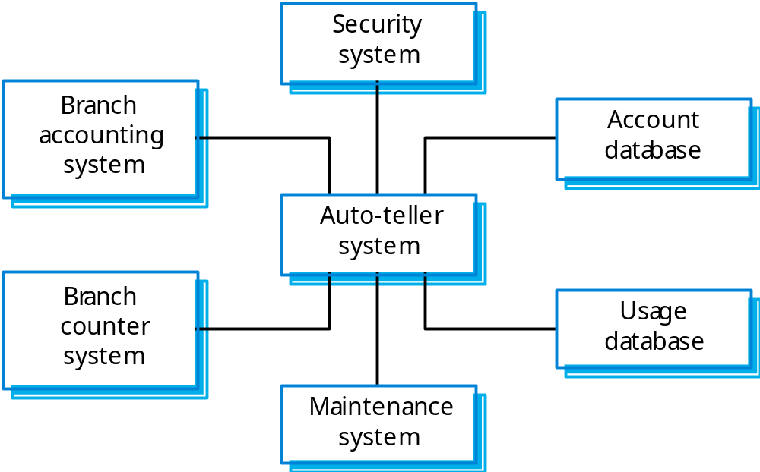
The context of an ATM system

Slide 5
Behavioural models
Behavioural models are used to describe the overall behaviour of a system.
Two types of behavioural model are:
  Data processing models that show how data is processed as it moves through the system;
  State machine models that show the systems response to events.
These models show different perspectives so both of them are required to describe the system’s behaviour.

Slide 6
Data-processing models
Data flow diagrams (DFDs) may be used to model the system’s data processing.
These show the processing steps as data flows through a system.
DFDs are an intrinsic part of many analysis methods.
Simple and intuitive notation that customers can understand.
Show end-to-end processing of data.

Slide 7
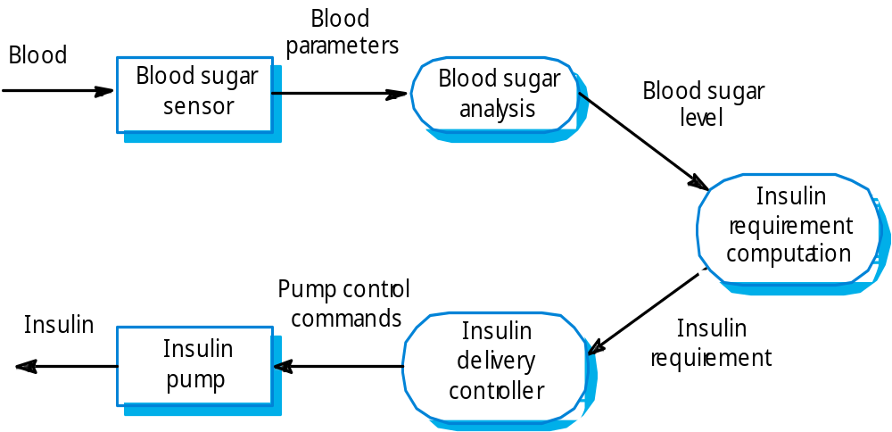
Insulin pump DFD

Slide 8
State machine models
These model the behaviour of the system in response to external and internal events.
They show the system’s responses to stimuli so are often used for modelling real-time systems.
State machine models show system states as nodes and events as arcs between these nodes. When an event occurs, the system moves from one state to another.
Statecharts are an integral part of the UML and are used to represent state machine models.

Slide 9
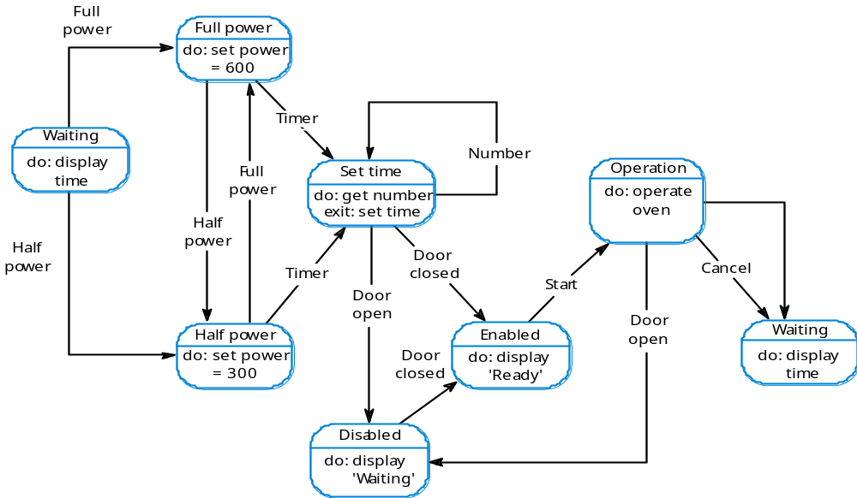
Microwave oven model

Slide 10
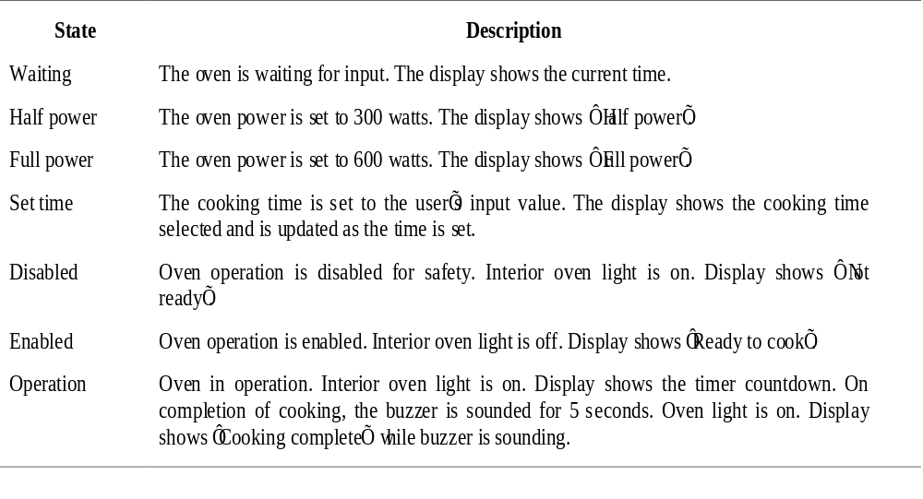
Microwave oven state description

Slide 11
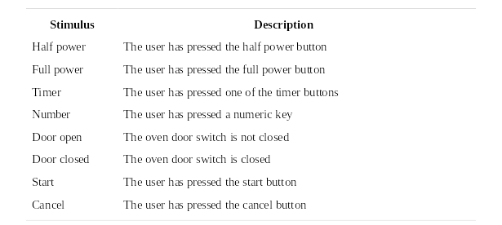
Microwave oven stimuli

Slide 12
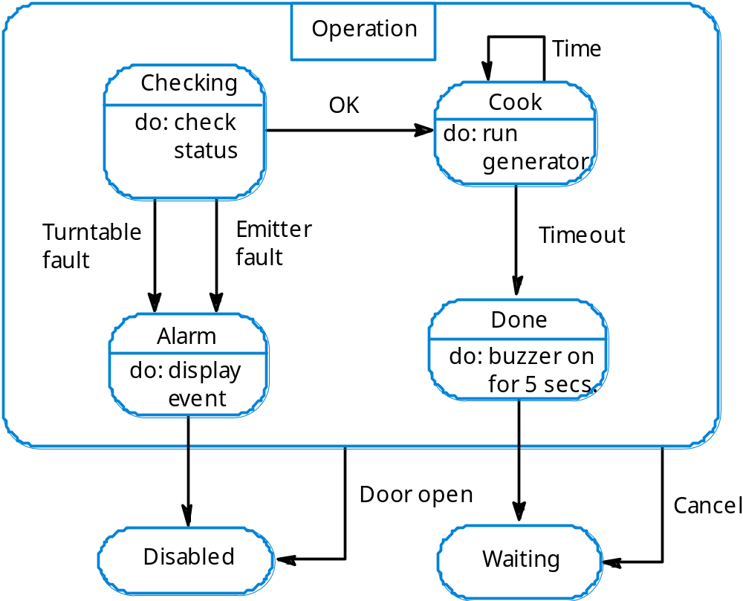
Microwave oven operation

Slide 13
Semantic data models
Used to describe the logical structure of data processed by the system.
An entity-relation-attribute model sets out the entities in the system, the relationships between these entities and the entity attributes
Widely used in database design. Can readily be implemented using relational databases.
No specific notation provided in the UML but objects and associations can be used.

Slide 14
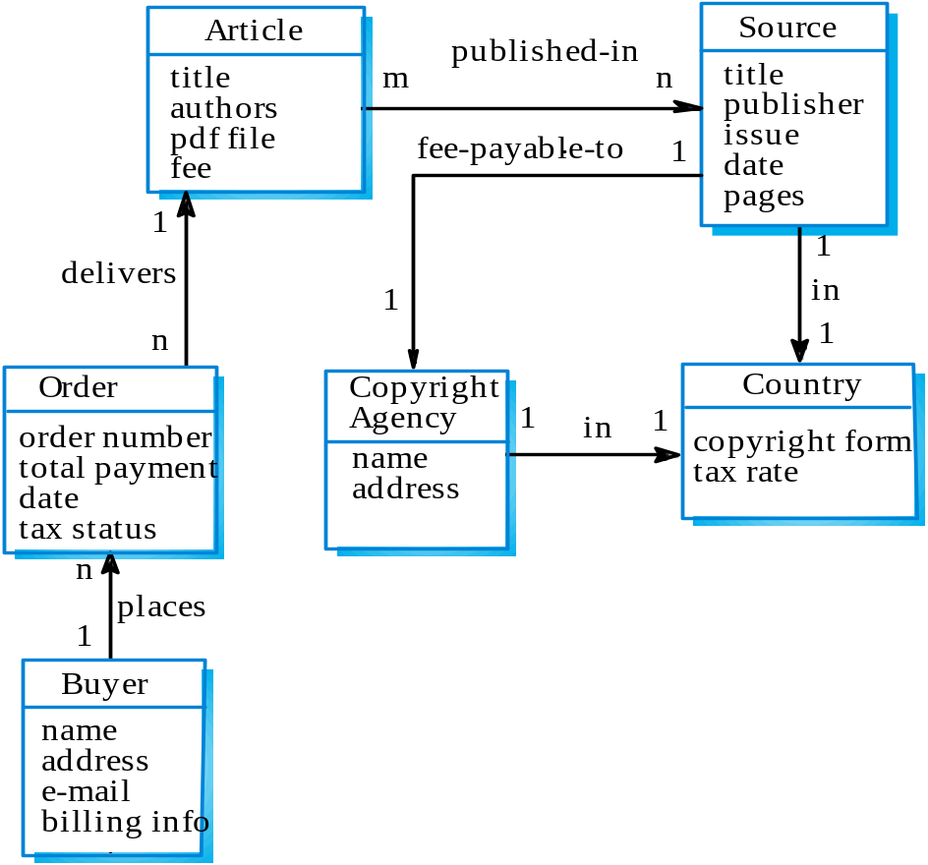
Library semantic model

Slide 15
Data dictionaries
Data dictionaries are lists of all of the names used in the system models. Descriptions of the entities, relationships and attributes are also included.
Advantages
  Support name management and avoid duplication;
  Store of organisational knowledge linking analysis, design and implementation;
Many CASE workbenches support data dictionaries.

Slide 16
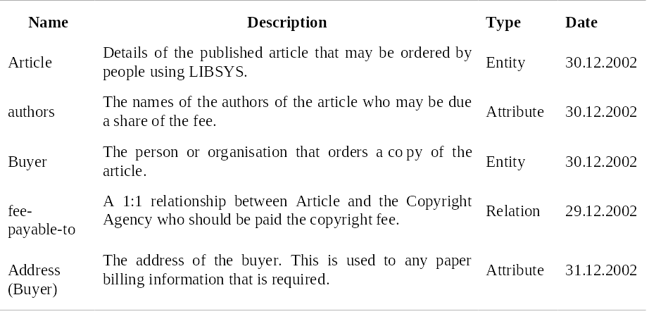
Data dictionary entries

Slide 17
Object models
Natural ways of reflecting the real-world entities manipulated by the system
More abstract entities are more difficult to model using this approach
Object class identification is recognised as a difficult process requiring a deep understanding of the application domain
Object classes reflecting domain entities are reusable across systems

Slide 18
Object models and the UML
The UML is a standard representation devised by the developers of widely used object-oriented analysis and design methods.
It has become an effective standard for object-oriented modelling.
Notation
  Object classes are rectangles with the name at the top, attributes in the middle section and operations in the bottom section;
  Relationships between object classes (known as associations) are shown as lines linking objects;
  Inheritance is referred to as generalisation and is shown ‘upwards’ rather than ‘downwards’ in a hierarchy.

Slide 19
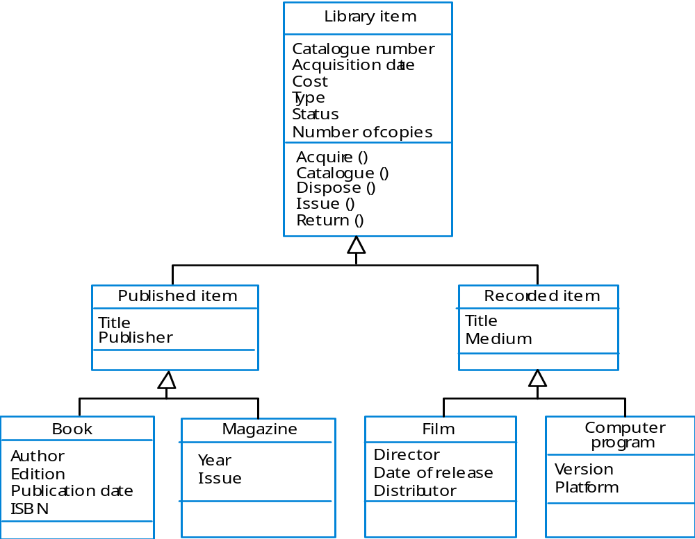
Library class hierarchy

Slide 20
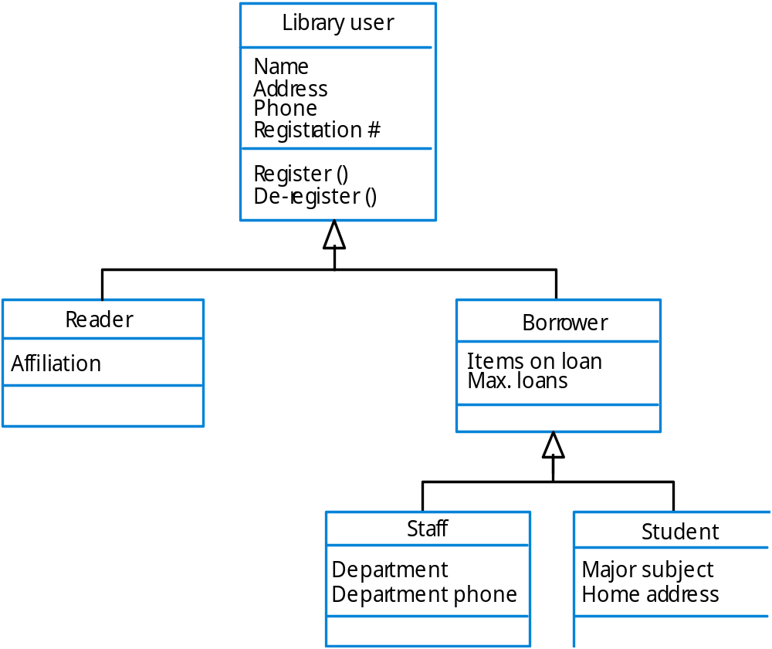
User class hierarchy

Slide 21
Multiple inheritance
Rather than inheriting the attributes and services from a single parent class, a system which supports multiple inheritance allows object classes to inherit from several super-classes.
This can lead to semantic conflicts where attributes/services with the same name in different super-classes have different semantics.
Multiple inheritance makes class hierarchy reorganisation more complex.

Slide 22
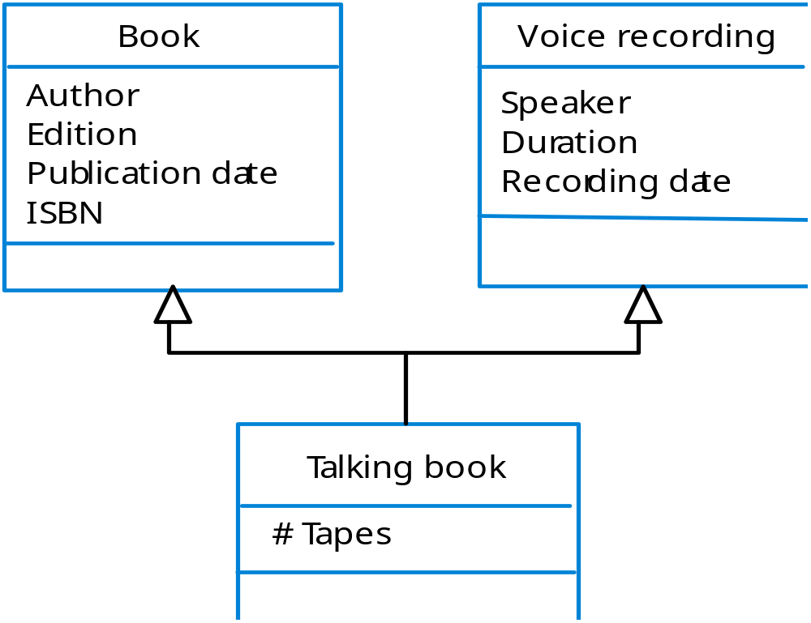
Multiple inheritance

Slide 23
Object aggregation
An aggregation model shows how classes that are collections are composed of other classes.
Aggregation models are similar to the part-of relationship in semantic data models.

Slide 24
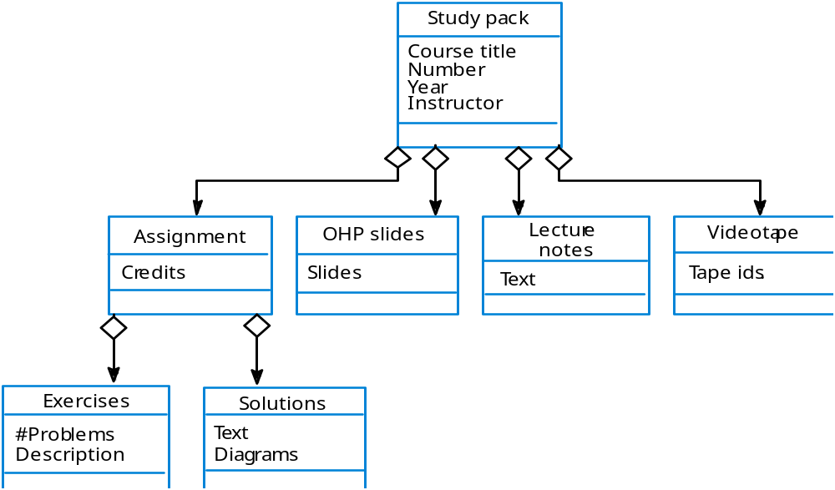
Object aggregation

Slide 25
Object behaviour modelling
A behavioural model shows the interactions between objects to produce some particular system behaviour that is specified as a use-case.
Sequence diagrams (or collaboration diagrams) in the UML are used to model interaction between objects.

Slide 26
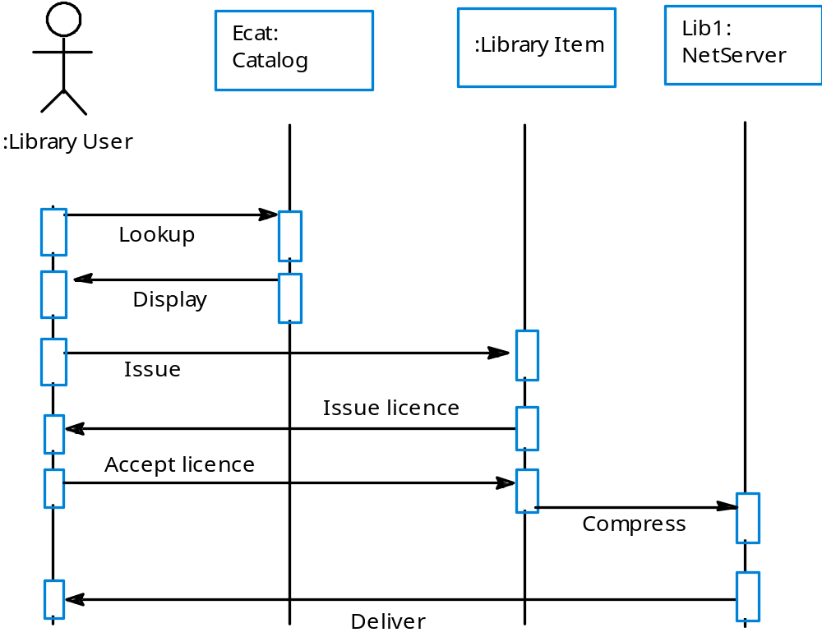
Issue of electronic items

Slide 27
CASE workbenches
A coherent set of tools that is designed to support related software process activities such as analysis, design or testing.
Analysis and design workbenches support system modelling during both requirements engineering and system design.
These workbenches may support a specific design method or may provide support for a creating several different types of system model.

Slide 28
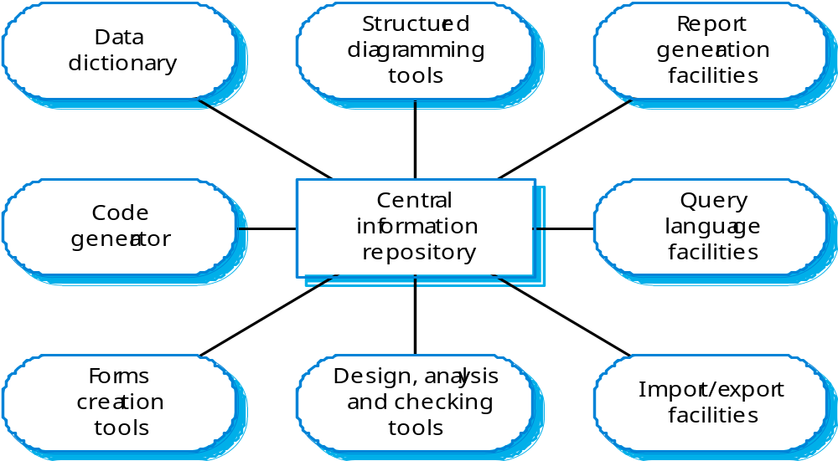
An analysis and design workbench

